Slide 1
Module 3
ARM MEMORY MAP, MEMORY ACCESS AND STACK

Slide 2
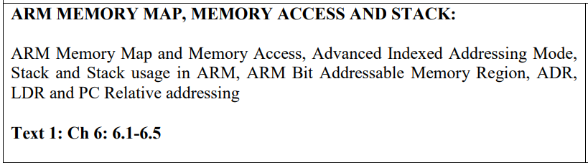

Slide 3
ARM Memory Map and Memory Access
32
The ARM CPU uses __________________-bit addresses which gives us a maximum
of ______________________________GB (gigabytes) of memory space.
This 4GB of memory space has addresses, _________________________________
meaning each byte is assigned a unique address (ARM is a byte-addressable CPU).
04
0x00000000 to 0xFFFFFFFF

Slide 4
ARM Memory Map and Memory Access

Slide 5
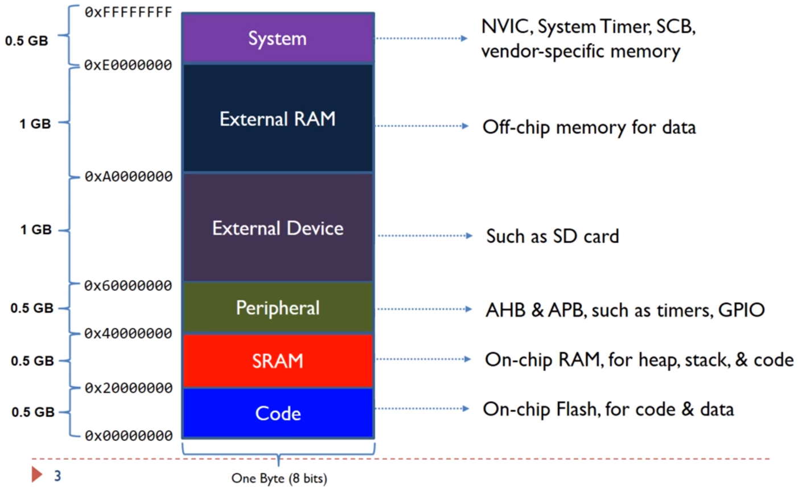
No ARM manufacturer has populated the entire 4 GB of memory space with on-chip ROM, RAM, and I/O peripherals.
The 4GB of memory space is divided into three regions: code, data, and peripheral devices.
PPB – Private Peripheral Bus
Sample Memory Space Allocation in ARM Cortex
Flash ROM is used for program code
The address locations of memory used by
SRAM for scratch pad data
varies among the family members and chip manufacturers
Memory-mapped I/O ports for peripherals

Slide 6
Example:
A given ARM chip has the following address assignments. Calculate the space and the amount of memory given to each section.
(a) Address range of 0x00100000 – 0x00100FFF for EEPROM
(b) Address range of 0x40000000 – 0x40007FFF for SRAM
(c) Address range of 0x00000000 – 0x0007FFFF for Flash
(d) Address range of 0xFFFC0000 – 0xFFFFFFFF for peripherals
(a) 0xFFF = 4K bytes.
(b) 7FFF = 32K bytes.
(c) 7FFFF = 512K bytes.
(d) 3FFFF = 256K bytes.

Slide 7
A given ARM chip has the following address assignments. Calculate the space and the
amount of memory given to each section.
(a) Address range of 0x00100000 – 0x00100FFF for EEPROM
(b) Address range of 0x40000000 – 0x40007FFF for SRAM
(c) Address range of 0x00000000 – 0x0007FFFF for Flash
(d) Address range of 0xFFFC0000 – 0xFFFFFFFF for peripherals
Solution:
(a) With address space of 0x00100000 to 00100FFF, we have 00100FFF – 00100000 =
0FFF bytes. Converting 0FFF to decimal, we get 4,095 + 1, which is equal to 4K bytes.
(b) With address space of 0x40000000 to 0x40007FFF, we have 40007FFF – 40000000 =
7FFF bytes. Converting 7FFF to decimal, we get 32,767 + 1, which is equal to 32K bytes.
(c) With address space of 0000 to 7FFFF, we have 7FFFF – 0 = 7FFFF bytes. Converting
7FFFF to decimal, we get 524,287 + 1, which is equal to 512K bytes.
(d) With address space of FFFC0000 to FFFFFFFF, we have FFFFFFFF–FFFC0000 =
3FFFF bytes. Converting 3FFFF to decimal, we get 262,143 + 1, which is equal to 256K
bytes.

Slide 9
ARM buses and memory access
ARM systems use DRAM for the RAM memory, just like the x86 and Pentium PCs.
DRAM as primary memory to store both the operating systems and the applications.
In such systems, the Flash memory will be holding the POST (power on self test), BIOS (basic Input/output systems) and boot programs.
Same as x86 system, such systems have both on-chip and off-chip high speed SRAM for cache.
ARM chips on the market with some on-chip Flash ROM, SRAM, and memory decoding circuitry for connection to external (off-chip) memory.
Memory Connection Block Diagram in ARM
Notes:
In ARM systems for Microsoft Windows, Unix, and Android operating systems the ARM motherboards use DRAM
As the ARM CPU is pushed into the laptop, desktop, and tablets PCs, and the high end of embedded systems products such as routers,
A power-on self-test (POST) is a set of routines performed by firmware or software immediately after a computer is powered on, to determine if the hardware is working as expected. The process would proceed further only if the required hardware is working correctly, else the BIOS(Basic Input Output Software) would issue an error message.
D31–D0 Data bus The 32-bit data bus of the ARM provides the 32-bit data path to the on-chip and offchip memory and peripherals. They are grouped into 8-bit data chunks, D0–D7, D8–D15, D16–D23, and D24–D31.

Slide 10
D31–D0 Data bus
The 32-bit data bus of the ARM provides the 32-bit data path to the on-chip and offchip memory and peripherals.
They are grouped into 8-bit data chunks, D0–D7, D8–D15, D16–D23, and D24–D31.
A31–A0
These signals provide the 32-bit address path to the on-chip and off-chip memory and peripherals.
Since the ARM supports data access of byte (8 bits), half word (16 bits), and word (32 bits), the buses must be able to access any of the 4 banks of memory connected to the 32-bit data bus.
The A0 and A1 are used to select one of the 4 bytes of the D31-D0 data bus.

Slide 11
Memory Block Diagram in ARM

Slide 12
AHB and APB buses
The ARM CPU is connected to the on-chip memory via an AHB (advanced high-performance bus).
The AHB is used not only for connection to on-chip ROM and RAM, it is also used for connection to some of the high speed I/Os (input/output) such as GPIO (general purpose I/O).
AHB and APB in ARM
ARM chip also has the APB (advanced peripherals bus) bus dedicated for communication with the on-chip peripherals such as timers, ADC, serial COM, SPI, I2C, and other peripheral ports.
While we need the 32-bit data bus between CPU and the memory (RAM and ROM), many slower peripherals are 8 or 16 bits and there is no need for entire fast 32-bit data bus pathway.
For this reason, ARM uses the AHB-to-APB bridge to access the slower on-chip devices such as peripherals.

Slide 13
Bus cycle time
To access a device such as memory or I/O, the CPU provides a fixed amount of time called a bus cycle time.
The bus cycle time used for accessing memory is often referred to as MC (memory cycle) time.
The time from when the CPU provides the addresses at its address pins to when the data is expected at its data pins is called memory read cycle time.
While for on-chip memory the cycle time can be 1 clock, in the off-chip memory the cycle time is often 2 clocks.
If memory is slow and its access time does not match the MC time of the CPU, extra time can be requested from the CPU to extend the read cycle time. This extra time is called a wait state (WS).

Slide 14
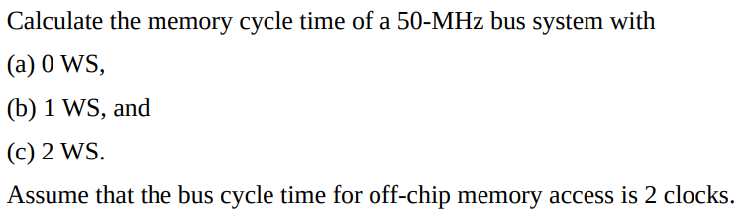
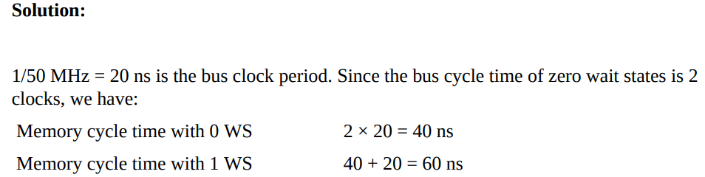

Slide 15
Bus Bandwidth
The rate of data transfer
Measure
how fast buses transfer information between 3 region
CPU Memory Peripherals
Wider the data bus
The higher the bus bandwidth
Increasing the size for system on-chip (SOC) or the printed circuit board size for off-chip memory
Increasing the size for system on-chip (SOC) or the printed circuit board size for off-chip memory
The speed of the CPU must be matched with the higher bus bandwidth; otherwise, there is no use for a fast CPU.
Bus bandwidth is measured in MB (megabytes) per second
Notes:
The wider the data bus, the higher the bus bandwidth. However, the advantage of the wider external data bus comes at the cost of increasing the die size for system on-chip (SOC) or the printed circuit board size for off-chip memory. Now you might ask why we should care how fast buses transfer information between the CPU and outside, as long as the CPU is working as fast as it can. The problem is that the CPU cannot process information that it does not have. In other words, the speed of the CPU must be matched with the higher bus bandwidth; otherwise, there is no use for a fast CPU. This is like driving a Porsche or Ferrari in first gear; it is a terrible under usage of CPU power.

Slide 16
There are two ways to increase the bus bandwidth:
Either use a wider data bus or
shorten the bus cycle time (or do both)
Although the processor’s speed can go to 1 GHz or higher, the bus speed for off-chip memory is limited to around 200 MHz.
Notes:
In the above formula, bus cycle time can be for both memory and I/O since the ARM uses the memory mapped I/O. Example 6-2 clarifies the concept of bus bandwidth. As can be seen from Example 6-2, there are two ways to increase the bus bandwidth: Either use a wider data bus or shorten the bus cycle time (or do both). That is exactly what many processors have done. Again, it must be noted that although the processor’s speed can go to 1 GHz or higher, the bus speed for off-chip memory is limited to around 200 MHz. The reason for this is that the signals become too noisy for the circuit board if they are above 100 MHz.

Slide 17
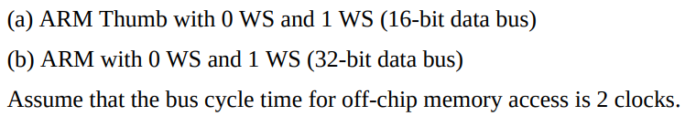
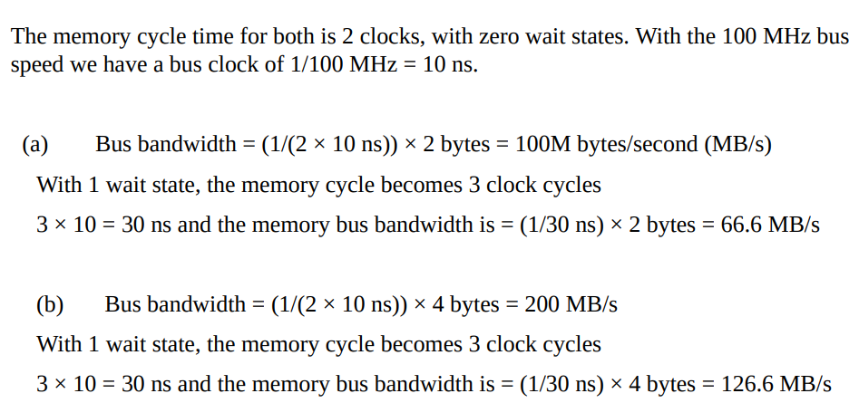
Calculate memory bus bandwidth for the following CPU if the bus speed is 100 MHz.

Slide 18
Code memory region
The 4 GB of ARM memory space is organized as 1G × 32 bits since the ARM instructions are 32-bit.
The internal data bus of the ARM is 32-bit, allowing the transfer of one instruction into the CPU every clock cycle.
The fetching of an instruction in every clock cycle can work only if the code is word aligned, meaning each instruction is placed at an address location ending with 0, 4, 8, or C.

Slide 19
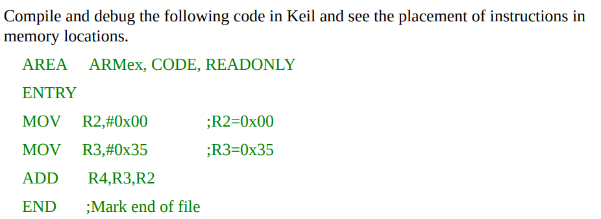
Notes:
As you can see in the figure, the first MOV instruction starts from location 0x00000000, the second MOV instruction starts from location 0x00000004 and the ADD instruction starts from location 0x00000008.
The following image displays the first locations of memory. The code of the first MOV instruction is located in the first word (four bytes) of memory which is word aligned. The same rule applies for the other instructions. Note that the code of MOV R2,0 is E3 A0 20 00 but 00 20 A0 E3 is stored in the memory. We will discuss the reason in this chapter when we focus on the concept of big endian and little endian.

Slide 20
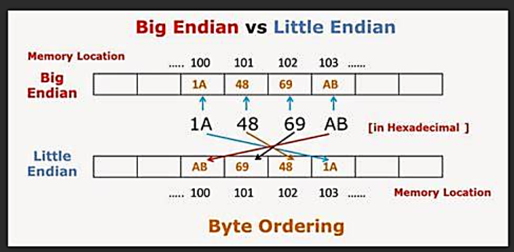

Slide 21
SRAM memory region
A section of the memory space is used by SRAM. The SRAM can be on-chip or offchip (external).
This on-chip SRAM is used by the CPU to store parameters. It is also used by the CPU for the purpose of the stack.
Data misalignment in SRAM
If the data is aligned, for every memory read cycle, the ARM brings in 4 bytes of information (data or code) using the D31–D0 data bus.
The single cycle access of memory is also used by ARM to bring into registers 4 bytes of data every clock cycle assuming that the data is aligned. To make sure that data are also aligned we use the align directive.
Notes:
The case of misaligned data has a major effect on the ARM bus performance. If the data is aligned, for every memory read cycle, the ARM brings in 4 bytes of information (data or code) using the D31–D0 data bus. Such data alignment is referred to as word alignment.
To make data word aligned, the least significant digits of the hex addresses must be 0, 4, 8, or C (in hex).
In other words, the single cycle access of memory is also used by ARM to bring into registers 4 bytes of data every clock cycle assuming that the data is aligned. To make sure that data are also aligned we use the align directive. The use of align directive for RAM data makes sure that each word is located at an address location ending with address of 0, 4, 8, or C.
If our data is word size (using DCDU directive) then the use of align directive at the start of the data section guaranties all the data placements will be word aligned. When a word size data is defined using the DCD directive, the assembler aligns it to be word aligned.

Slide 22
Accessing non-aligned data
LDR R1, [R0] R0=0x80000000
LDR R1, [R0] R0=0x80000001 7 bytes contents of memory locations 0x80000000 through 0x80000007 are being fetched in two consecutive
Cycles.
Memory Access for Aligned and Non-aligned Data
Notes:
As we have stated many times before, ARM defines 32-bit data as a word.
The address of a word can start at any address location. For example, in the instruction “LDR R1,[R0]” if R0 = 0x20000004, the address of the word being fetched into R1 starts at an aligned address.
In the case of “LDR R1,[R0]” if R0 = 0x20000001 the address starts at a non-aligned address.
In systems with a 32-bit data bus, accessing a word from a nonaligned addressed location can be slower.
This issue is important and applies to all 32-bit processors.
In the 8-bit system, accessing a word (4 bytes) is treated like accessing four consecutive bytes regardless of the address location.
Since accessing a byte takes one memory cycle, accessing 4 bytes will take 4 memory cycles. In the 32-bit system, accessing a word with an aligned address takes one memory cycle. That is because each byte is carried on its own data path of D0–D7, D8–D15, D16–D23, and D24–D31 in the same memory cycle.
However, accessing a word with a non-aligned address requires two memory cycles. For example, see how accessing the word in the instruction “LDR R1, [R0]” works as shown in Figure 6-5. As a case of aligned data, assume that R0 = 0x80000000. In this instruction, 4 bytes contents of memory locations 0x80000000 through 0x80000003 are being fetched in one cycle. In only one cycle, the ARM CPU accesses locations 0x80000000 through 0x80000003 and puts it in R1.

Slide 23
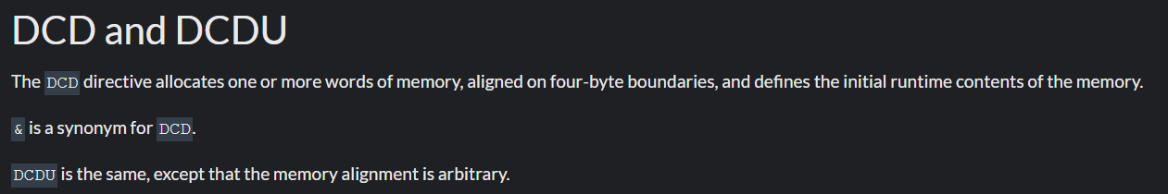

Slide 24
Using LDR instruction with DCD and ALIGN directives
The DCD and DCDU directives are used for 32-bit (word) data. The DCD directive ensures 32-bit data types are aligned, in contrast to DCDU which does not. DCD is used as follows:
VALUE1 DCD 0x99775533
This ensures that VALUE1, a word-sized operand, is located in a word aligned address location.
An instruction accessing it will take only a single memory cycle.
The one-time use of ALIGN directive at the beginning of data area using DCDU makes the data aligned for that group of data.

Slide 25
Using LDRH with DCW and ALIGN directives
With DCWU, we must use the ALIGN directive in the data area of a given program to ensure they are aligned. This is in contrast to the DCW directive which ensures data type to be half-word aligned.
This is especially the case when we use the LDRH instruction.
Example:
LDR R1,=0x80000000 ;R1=0x80000000
LDR R3,=0xF31E4598 ;R3=0xF31E4598
LDR R4,=0x1A2B3D4F ;R4=0x1A2B3D4F
STR R3,[R1]
STR R4,[R1,#4]
LDRH R2, [R1]
LDRH R2, [R1,#1]
LDRH R2, [R1,#2]
LDRH R2, [R1,#3]

Slide 26
LDRH R2, [R1]
LDRH R2, [R1,#1]
LDRH R2, [R1,#2] instructions take only one memory cycle.
But LDRH R2, [R1,#3] will take two memory cycles to load the data

Slide 27
Using LDRB with DCB and ALIGN directives
The problem of misaligned data does not exist when the data size is bytes. In cases such as using the string of ASCII characters with the DCB directive, accessing a byte takes the same amount of time (one memory cycle) as an aligned word (4 bytes), regardless of the address location of the data.
Peripheral region
A section of memory is set aside for peripherals. The type of peripherals and memory address locations used is unique to a vendor. The ARM manufacturers provide the details of memory map for the peripherals.

Slide 28
Harvard Architecture and ARM
In recent years many ARM manufacturers are using the Harvard architecture for ARM CPUs.
Old ARM architectures up to ARM7 use Von Neumann architecture.
The Harvard architecture feeds the CPU with both code and data at the same time via two sets of buses, one for code and one for data. This increases the processing power of the CPU since it can bring in more information.

Slide 29
Von Neumann vs. Harvard Architecture

Slide 30
Stack and Stack Usage in ARM
Nested calls in ARM:
Upon calling a subroutine from the main program using the BL instruction, R14, the linker register, keeps track of where the CPU should return after completing the subroutine. Now, if we have another call inside the subroutine using the BL instruction, then it is our job to store the original R14 on the stack. Failure to do that will end up crashing the program.
The stack is a section of RAM used by the CPU to store information temporarily.
This information could be data or an address or CPU registers when calling a subroutine.
Stack is also widely used when executing an interrupt service routine (ISR).

Slide 31
How stacks are accessed
If the stack is a section of RAM, there must be a register inside the CPU to point to it. In the ARM CPU the register used to access the stack is R13.
The storing of CPU information such as the registers on the stack is called a PUSH, and loading the contents of the stack back into a CPU register is called a POP. In other words, a register is pushed onto the stack to save it and popped off the stack to retrieve it.

Slide 32
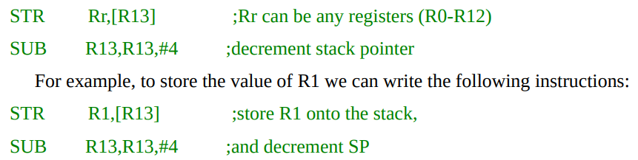
Pushing onto the stack
The stack pointer (SP) points to the top of the stack (TOS).
As we push (store) data onto the stack, the data are saved in RAM (where the SP points to) and SP must be decremented (or incremented) to point to the next location.
In the ARM we have a choice of either incrementing the SP or decrementing it. We must actually code the instruction for stack pointer decrementation (or incrementation)
To push a register onto stack we use the STR and SUB instructions

Slide 33
Popping from the stack
Popping (loading) the contents of the stack back into a given register is the opposite process of pushing. When the POP is executed, the SP is incremented (or decremented) and the top location of the stack is copied (loaded) back to the register.
The stack is LIFO (Last-In-First-Out) memory.
To pop into a register from the stack we use the LDR and ADD instructions

Slide 34
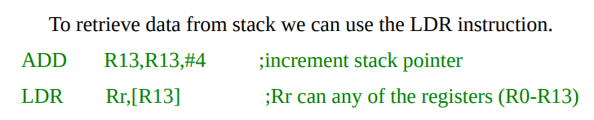
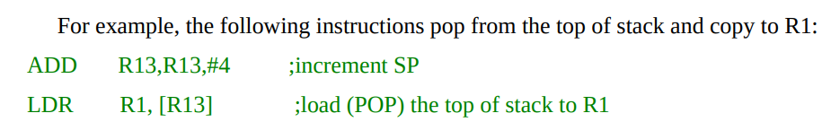

Slide 35
Initializing the stack pointer in ARM
When the ARM is powered up, the R13 (SP) register contains value 0.
Therefore, we must initialize the SP at the beginning of the program so that it points to somewhere in the internal SRAM. In ARM, we can make the stack to grow from a higher memory location to a lower memory location.
In this case when we push (store) onto the stack the SP is decremented.
We can also make the stack to grow from a lower memory location to a higher memory location, therefore when we push (store) onto the stack, the SP is incremented.
It is common to initialize the SP to the uppermost RAM memory region, which means as we push data onto the stack, the stack pointer must be decremented.

Slide 36
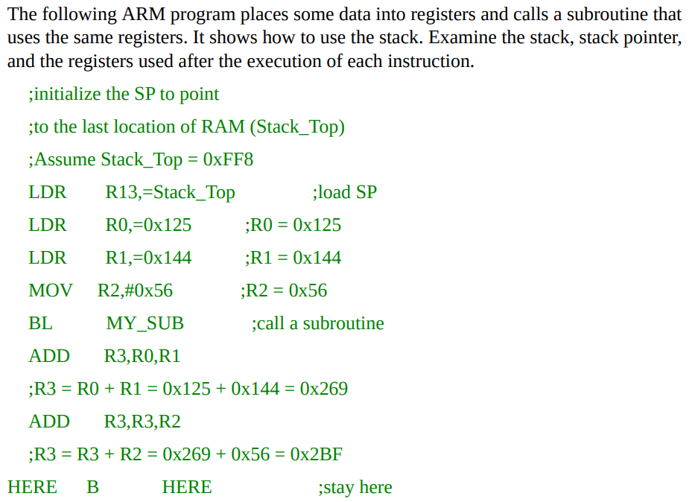
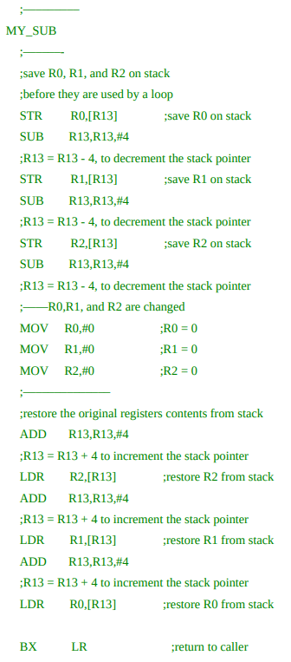

Slide 37
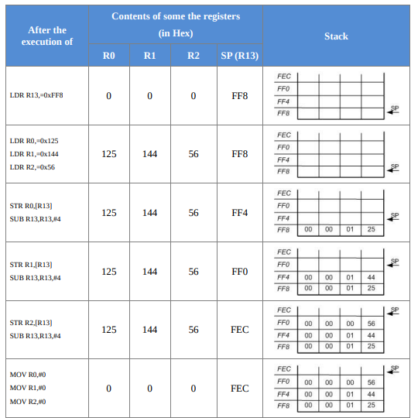
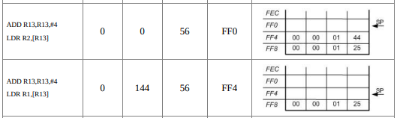
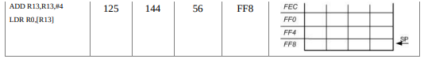

Slide 38
Using LDM and STM instructions for the stack
Another way to push register contents onto the stack is to use STM (store multiple) and LDM (load multiple) instructions.
STM
STM R11, {R0-R3}
;Store R0 through R3 onto memory pointed to by R11
STM R7, {R0,R3,R5}
;Store R0, R3, R5 onto memory pointed to by R7

Slide 39
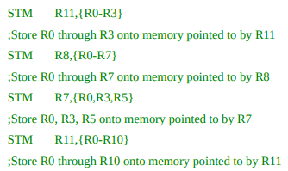
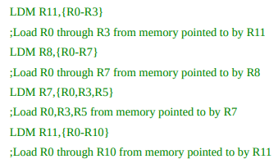
LDM
LDM R11, {R0-R3}
;Load R0 through R3 from memory pointed to by R11
LDM R7, {R0,R3,R5}
;Load R0,R3,R5 from memory pointed to by R7

Slide 40
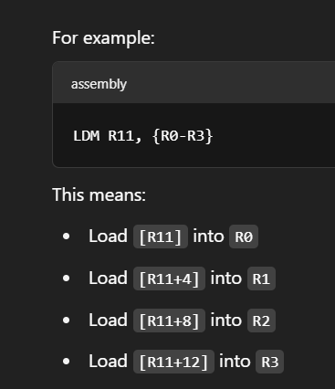
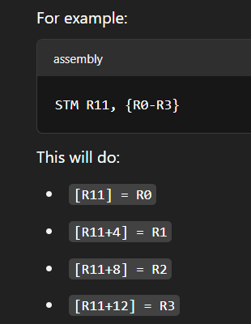

Slide 41
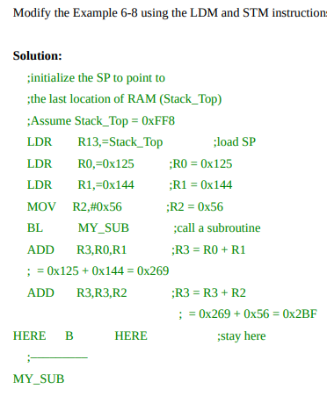
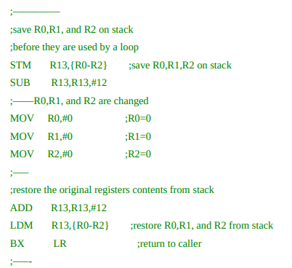

Slide 42
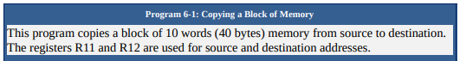
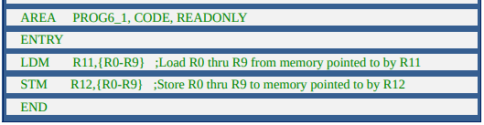

Slide 43
ARM Bit-Addressable Memory Region
One of the most important features of the CPU is the ability to access the RAM and I/O ports in bits instead of bytes. This is a very important and powerful feature of the ARM used widely in the embedded system design and applications.
Bit-addressable (bit-band) SRAM
Of the 4GB memory space of the ARM, a number of bytes are bit-addressable. The ARM literature refers to this region as the bit-band region. Since the ARM instruction is 32-bit and the CPU executes code one instruction at a time, the code (Flash ROM) space is always word size and word aligned,

Slide 44
The bit addressable RAM and I/O locations vary among the family members and vendors.
The ARM generic manual defines the location addresses of bit-band as 0x20000000 to 0x200FFFFF for SRAM and 0x40000000 to 0x400FFFFF for peripherals.
The bit-band (bit-addressable) regions are the only region that can be accessed in both bit and byte/halfword/word formats while the other area of memory must be accessed in byte/halfword/word size.
For the ARM Cortex-M, the bit-band SRAM addresses 0x20000000 to 0x200FFFFF (1M bytes) is given alias addresses of 0x22000000 to 0x23FFFFFF.
The bit addresses 0x22000000 to 0x2200001F are for the first byte of SRAM location 0x20000000, and 0x22000020 to 0x2200003F are the bit addresses of the second byte of SRAM location 0x20000001, and so on.

Slide 45
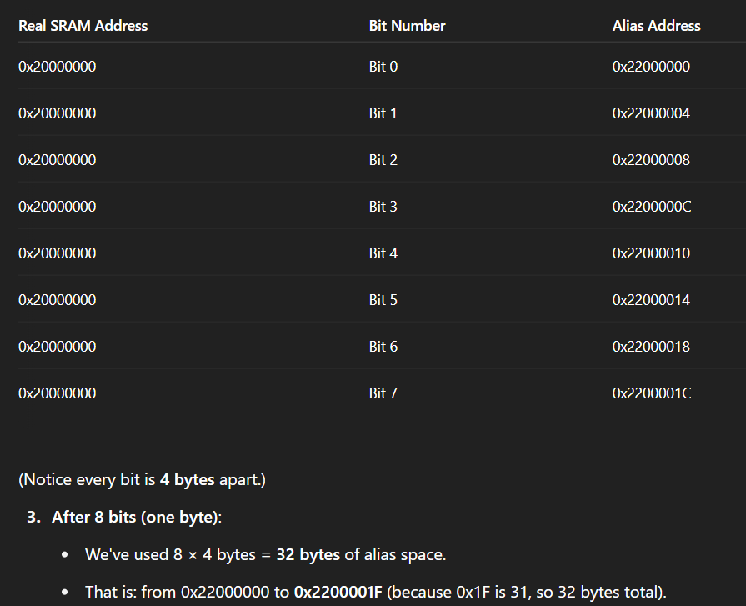

Slide 46
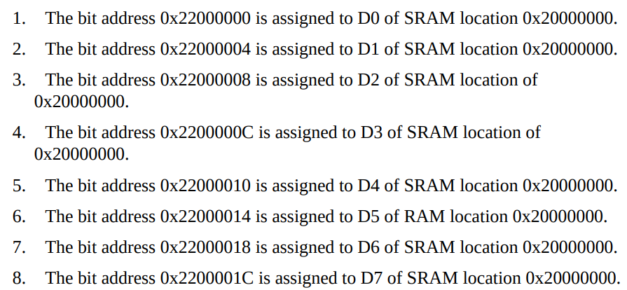
Notice that SRAM locations 0x20000000 – 0x200FFFFF are both byte-addressable and bit-addressable.
The only difference is when we access it in byte (or halfword or word) we use addresses 0x20000000 to 0x200FFFFF, but when they are accessed in bit, they are accessed via their alias addresses of 0x22000000 to 0x23FFFFFF.
The reason it is called aliases is because it is same physical location but accessed by two different addresses.
SRAM bit-addressable region and their alias addresses

Slide 47
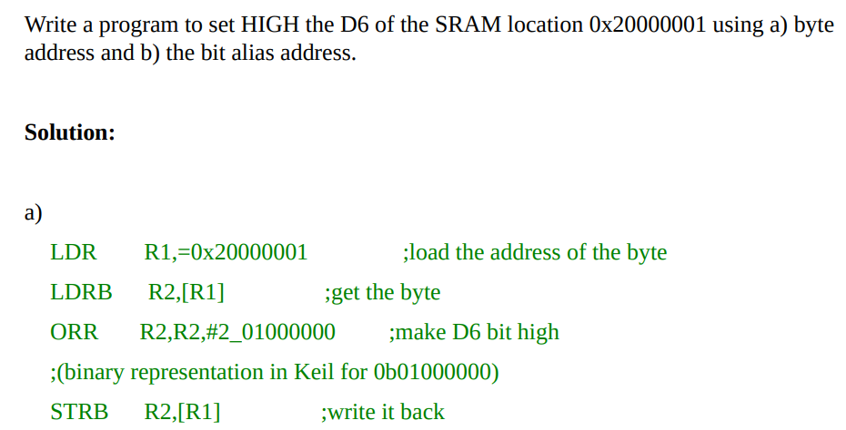
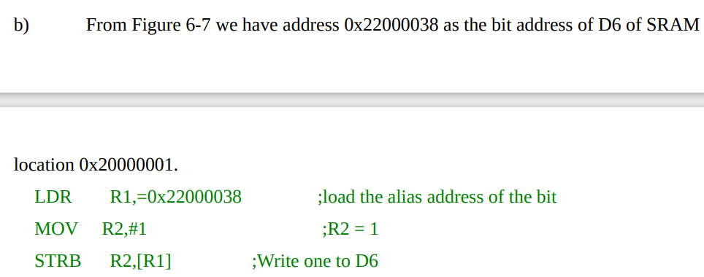

Slide 48
Peripheral I/O port bit-addressable region
The general purpose I/O (GPIO) and peripherals such as ADC, DAC, RTC, and serial COM port are widely used in the embedded system design.
ARM has set aside 1M bytes of address space to be used bit-band (bit-addressable) I/O and peripherals.
The address space assigned to bit-band peripherals and GPIO is 0x40000000 to 0x400FFFFF with address aliases of 0x42000000 to 0x43FFFFFF.

Slide 49
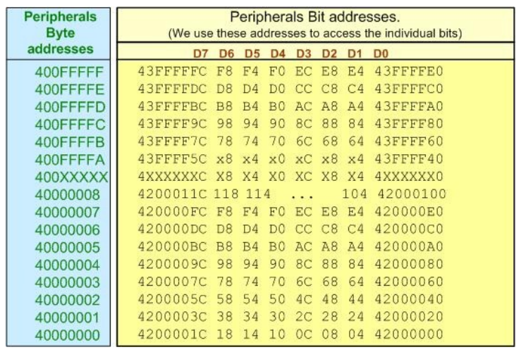
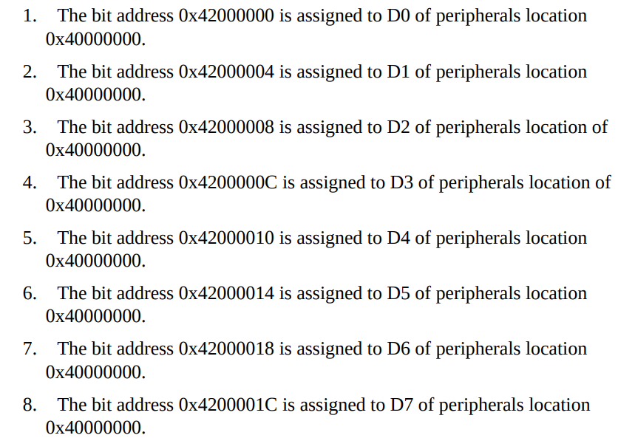
Peripherals bit-addressable region and their alias addresses

Slide 50
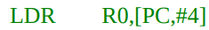
ADR, LDR, and PC Relative Addressing
LDR R0,[PC,offset]
For instance, if “LDR R0,[PC,#4]” is located in address 0x10.
The effective address is: 0x10 + 8 + 4 = 0x1C.
Notes:
In this way, the data which has a known distance from the current executing line can be accessed. As discussed, the PC register points 8 bytes (2 instructions) ahead of executing instruction. As a result, “LDR R0,[PC,#4]” accesses a memory location whose address is 4+8 bytes ahead of the current instruction. Generally speaking, the address of the memory location which is being accessed using “LDR R0,[PC,offset]” can be found using this formula: the address of current instruction + 8 + offset.
This addressing mode can be considered as a subset of indexed addressing modes. In ARM application notes, the program relative addressing mode is considered as a separate addressing mode.

Slide 51
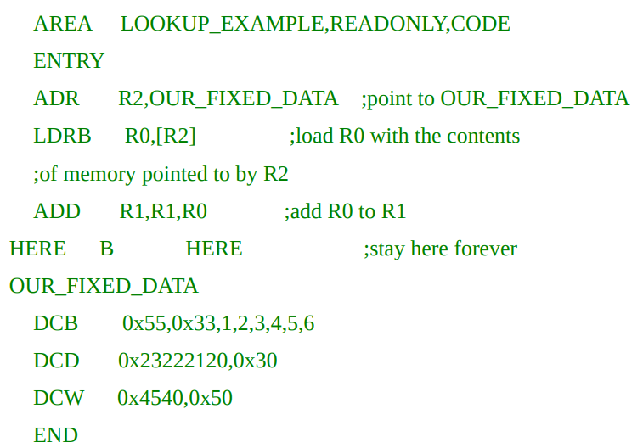
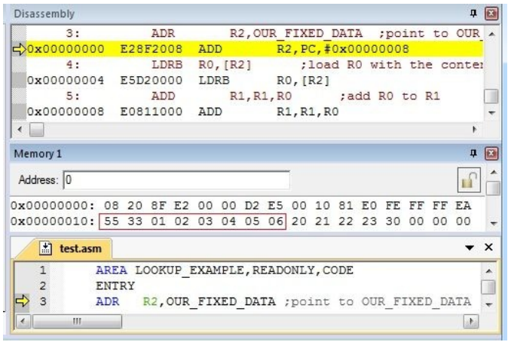
Implementing the ADR Directive (LDR Rn,=value)
Arm Developer The ADR instruction loads an address within a certain range, without performing a data load. ADR accepts a PC-relative expression, that is, a label with an optional offset where the address of the label is relative to the PC.
At compile time, the ADR will be replaced with
“ADD R2,PC,#0x08”
Since the instruction is in address 0x00, the instruction accesses location 0 + 8 + 0x08 = 0x10. As shown in the Figure, 0x10 is the address of OUR_FIXED_DATA.

Slide 52
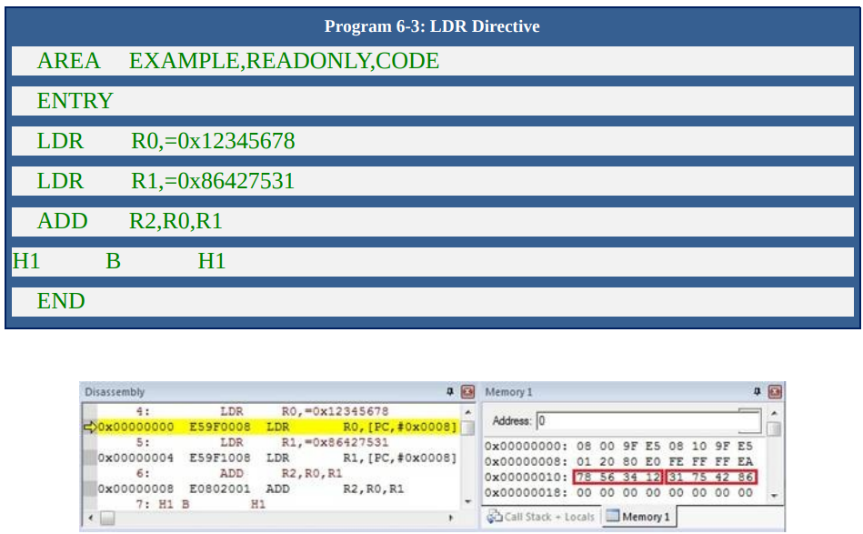
Implementing the LDR Directive
To implement the LDR directive, assembler stores the value as a fixed data in program memory and then accesses it using the LDR instruction and the PC relative addressing mode.
Notes:
For example, 0x12345678 is stored in memory locations 0x10–0x13, and the LDR directive is replaced with LDR R0,[PC,#0x08]. Since PC=0, the LDR R0, =0x1234567 is located at address 0x000000. Now we have 0+8+8=16=0x10.
The same way for the LDR R1,=0x86427531 is located in ROM address 0x00000004. Therefore we have 4+8+8=20=0x14, which is the address of the data 0x86427531.

Slide 53
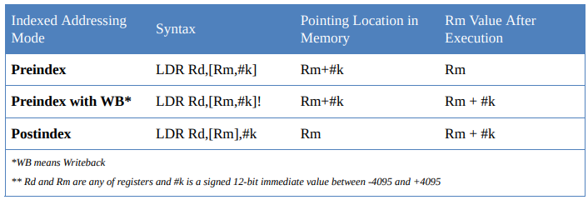
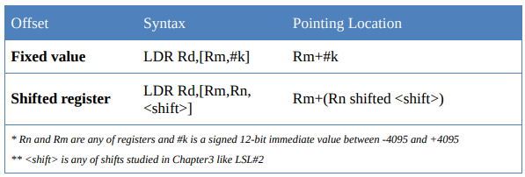
Advanced Indexed Addressing Mode
Indexed addressing mode
Notes:
In the indexed addressing mode, a register is used as a pointer to the data location. The ARM provides three indexed addressing modes. These modes are: preindex, preindex with write back, and post index.
Each of these indexed addressing mode can be used with offset of fixed value or offset of a shifted register

Slide 54
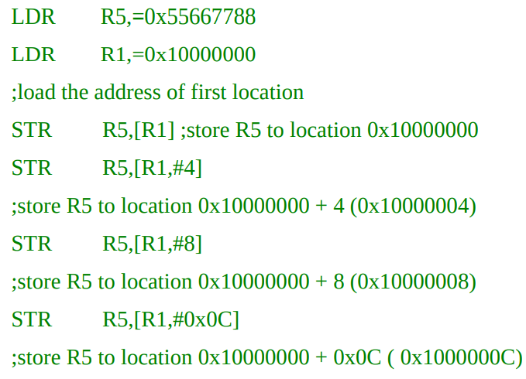
Pre-indexed addressing mode with fixed offset
In this addressing mode, a register and a positive or negative immediate value are used as a pointer to the data location.
The value of register does not change after instruction is executed.

Slide 55
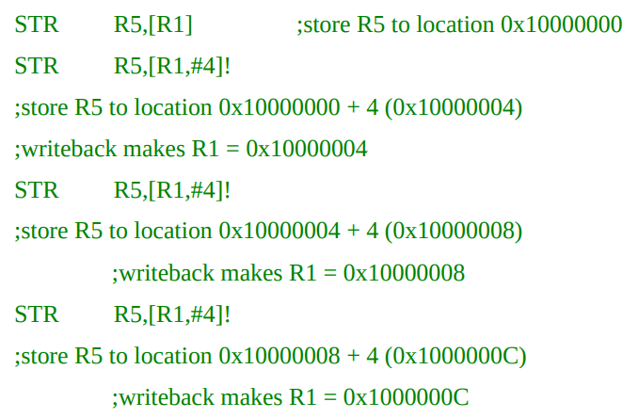
Pre-indexed addressing mode with write-back and fixed offset
Pre-indexed addressing mode with fixed offset except that the calculated pointer is written back to the pointing register.
! after the instruction to tell the assembler to enable writeback in the instruction.

Slide 56
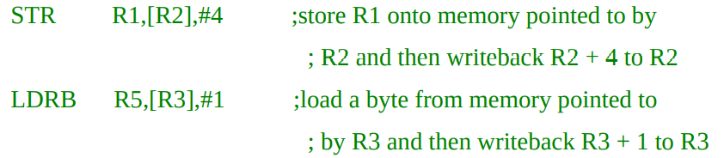
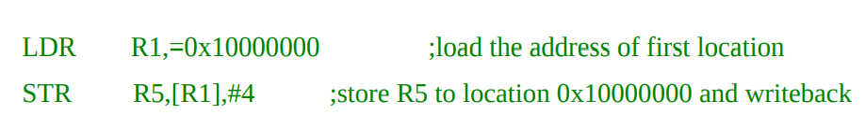
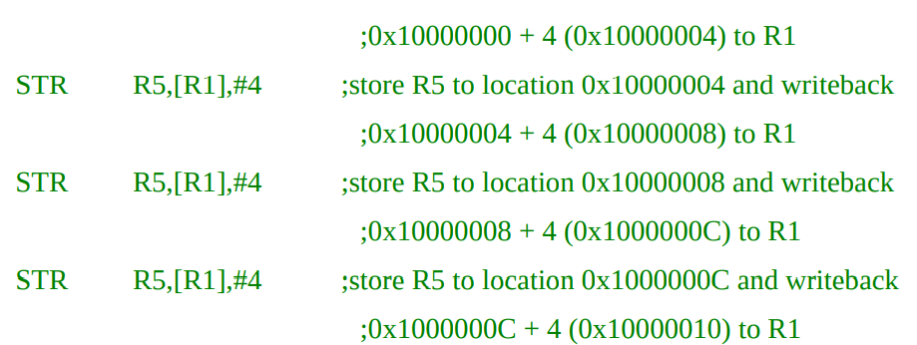
Postindexed addressing mode with fixed offset
Notes:
This addressing mode is like preindexed addressing mode with writeback and fixed offset except that the instruction is executed on the location that Rn is pointing to regardless of offset value.
Notice that writeback is by default enabled in postindexed addressing and there is no need to put ! after instructions because postindexing without writeback is useless as the index is neither used in the instruction nor written back to the pointing register.

Slide 57
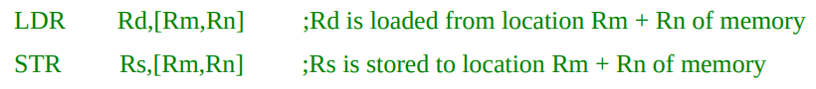
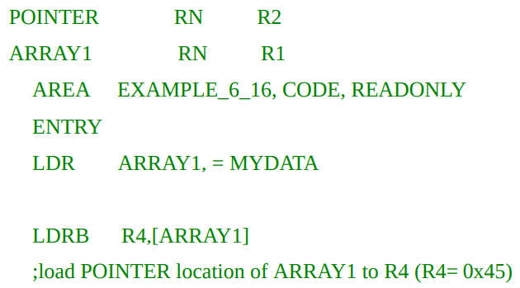
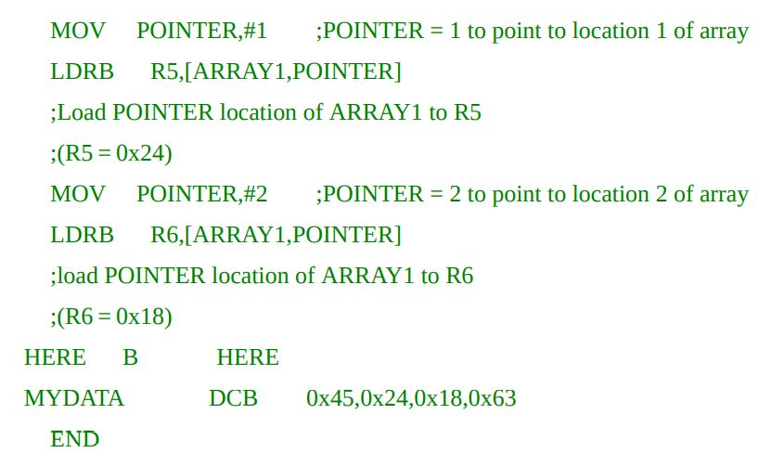
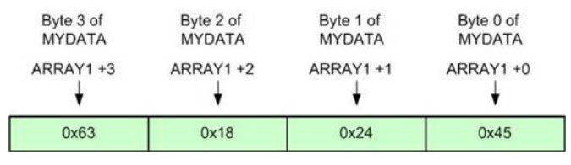
Pre-indexed address mode with offset of a shifted register
Notes:
After running the LDRB R4,[ARRAY1] instruction, location 0 of MYDATA is loaded to R4. Now R4=0x45.
Next, after running the LDRB R5,[ARRAY1,POINTER] instruction, location 1 of MYDATA is loaded to R5. Now R5 = 0x24.
Next, after running the LDRB R6,[ARRAY1,POINTER] instruction, location 2 of MYDATA is loaded to R6. So the content of R6 = 0x18.
Notice that purposely we used DCB and LDRB in this example so each location of MYDATA takes one byte.

Slide 58
Writeback options of STM and LDM
We can specify the action to be taken for the pointer. The action can be increment or decrement before or after the push or pop is done.
Option Description
IA Increment After
IA stands for Increment After and adds four to the pointer after load or storing each register.
IB Increment Before
IB stands for Increment Before and adds four to the pointer before load or storing each register.

Slide 59
DA Decrement After
DA stands for Decrement After and subtracts four from the pointer after load or storing each register.
DB Decrement Before
DB stands for Decrement Before and subtracts four from the pointer before load or storing each register.

Slide 60
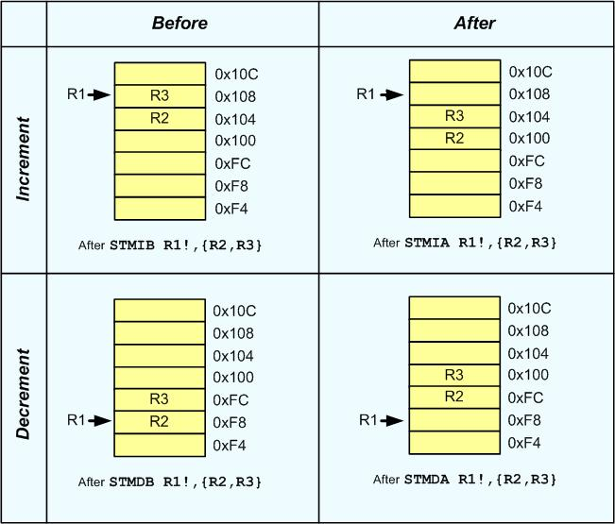
For further clarification assume that R1 = 0x100. Figure below shows the memory after
running STM R1!,{R2,R3} with each of IA, IB, DA and DB options.

Slide 61
We have four stack structure, either it is ascending or descending. The stack is called ascending when it is incremented after each store (PUSH) instruction and decremented after each load (POP) instruction.
It is called descending when it is decremented after each store (PUSH) instruction and incremented after each load (POP) instruction.
The stack pointer can point to the last filled location; in this case the stack is called Full Stack.
The stack pointer can point to the next available location, as well; which is called an Empty Stack.
To support 4 types of the stack STM and LDM instructions take four suffixes IA, IB, DA and DB.
If no suffix is used, the default action is IA

Slide 62
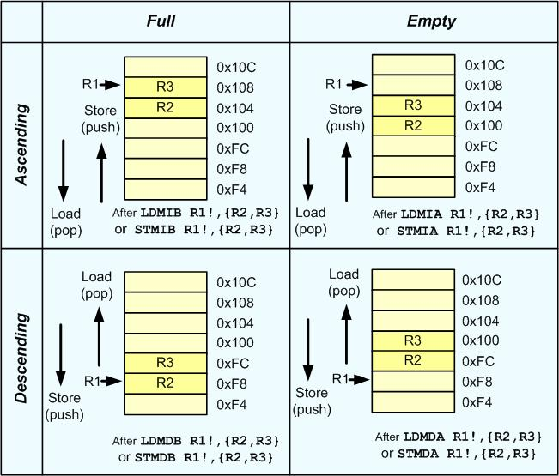
Notes:
To implement a Full Ascending stack we have to use STMIB because the stack pointer should increment on store instruction and it should be incremented before storing each register because it should point to full location.
On the other hand we have to use LDMDA for pop instruction because the stack pointer should decrement on load instruction and it should be decremented before loading each full location because it was pointing to an empty location before decrementing.
Table 6-5 lists appropriate load and store instruction for each stack structure. It is difficult and prone to error to remember which load and store should be used with each stack structure. To solve this problem, each of load and store options has alternate name which is easy to remember when it is used for stack operation.

Slide 63
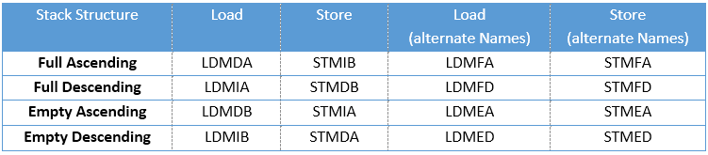
The four stack structures and the options of LDM and STM instructions
The stack structure used by ARM for PUSH, POP instructions and interrupt handling is a Full Descending stack using R13 as the stack pointer. To support Full Descending stack, STMDB and LDMIA pair of instructions should be used.

Slide 64
STMDB Store Multiple register and Decrement Before
Flags: Unaffected.
Format: STMDB Rn,{Rx,Ry,…}
Function: Stores registers Rx, Ry,… into consecutive memory locations. The starting address of memory location is given by Rn register. The source registers are separated by comma and placed in braces.
STMDB R11!, {R0, R1, R2, R3}
STMDB R11!, {R0-R3}
;Store R0 through R3 onto memory pointed to by R11 and update R11 with the final address
STMDB R11!, {R0, R5, R3}
;Store R0, R3 and R5 onto memory pointed to by R11 and update R11 with the final address

Slide 65
STMDB R11!, {R0-R3, R8, R7}
;Store R0 through R3, R7 and R8 onto memory pointed to by R11 and update R11 with the final address
LDMIA Load Multiple registers and Increment after each Access
Flags: Unaffected.
Format: LDMIA Rn, {Rx,Ry,..}
Function: This is the same as the LDM instructions. This IA (Increment the address after each Access) is the default. We use this for Poping (loading) multiple words from descending stack into CPU registers.
LDMIA R11!, {R0, R1, R2, R3}
LDMIA R11!, {R0-R3}
LDMIA R11!, {R0, R5, R3}

Slide 66
When the registers are pushed on to the stack, lower numbered registers are stored in the lower address and when popped, data from lower address goes into the lower numbered register.

Slide 67
PUSH and POP instructions.
PUSH: Push register onto stack
Flags: Unaffected.
Format: PUSH {reg_list} ;PUSH reg_list onto stack
Function: Copies the contents of registers stated in reg_list onto the stack and decrements SP by 4, 8, 12, 16, … depending on the number of registers in reg_list.
Example:
PUSH {R1} ;PUSH the R1 onto top of stack
PUSH {R1,R4,R7} ;PUSH R1,R4,R7 onto top of stack
PUSH {R2-R6} ;PUSH the R2,R3,R4,R5,R6 onto top of stack
PUSH {R0,R5} ;PUSH the R0 and R5 onto top of stack
PUSH {R0-R7} ;PUSH the R0 through R7 onto top of stack
The PUSH instruction is alias for STMDB R13!

Slide 68
POP: Pop register from Stack
Flags: Unaffected.
Format: POP {reg_list} ;reg_reg = words off top of stack
Function: Copies the words pointed to by the stack pointer to the registers indicated by the reg_list and increments the SP by 4, 8, 12, 16, … depending on the number of registers in the reg_list.
Example:
POP {R1} ;POP the top word of stack to R1
POP {R1,R4,R7} ;POP the top 3 words of stack to R1,R4,R7
POP {R2-R6} ;POP the top 5 words of stack to R2-R6
POP {R0,R5} ;POP the top 2 words of stack to R0 and R5
POP {R0-R7} ;POP the top 8 words of stack to R0-R7
The POP instruction is alias for LDMIA R13!

